Slide 1
CS112: Introduction to Python programming
Week 2: Data types I

Slide 2
Contents
Python Basics
Data types I:
Integer
Float
Boolean
String

Slide 3
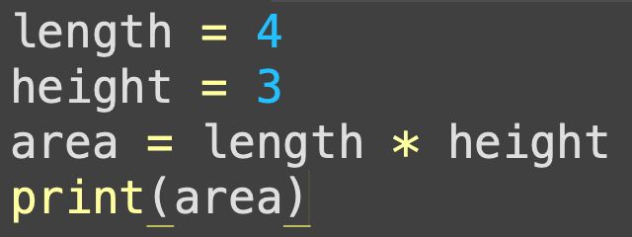


Programming with Python
source code
Python
interpreter
12

Slide 4

Programming with Python
python.org
source code
Python
interpreter
12

Slide 5
Programming with Python
python.org
source code
1. Line by line
Python
interpreter
2. Script (.py)
12

Slide 6


Programming with Python
python.org
3. IDE & Jupyter notebook
source code
1. Line by line
Python
interpreter
2. Script (.py)
12

Slide 7

Programming with Python
python.org
3. IDE & Jupyter notebook
conda
source code
1. Line by line
Python
interpreter
packages
2. Script (.py)
12

Slide 8

Programming with Python
python.org
3. IDE & Jupyter notebook
conda
source code
1. Line by line
Python
interpreter
packages
Python
interpreter
packages
2. Script (.py)
Environment1
Environment2
12

Slide 9
Python basics
A statement (语句) is an instruction that the Python interpreter can execute
a = 23
An expression (表达式) is an arrangement of operands (操作数) and operators(运算符) that are evaluated to make a new value
>>> 6 * 7
42

Slide 10
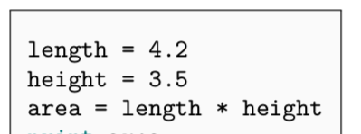
Python basics
Variables (变量) are containers for storing data values.
Do not need to declare(声明) variables before using them or declare their type.
A variable is created the moment we first assign a value to it.
The value stored in a variable can be changed during program execution
x = 100
x = "hundred"

Slide 11


Python basics
“=” is the simple assignment operator (赋值运算符):
variable_name = value
it assigns the value on the right to the variable on the left.
5 = a
a = 5
a = a + 1
a += 1
Compound assignment operators (复合赋值运算符): They perform the operation of the operator on both operands and store the result of that operation into the left operand, which must be a modifiable value.
+=, -=, *=, and /=
%=, **=, and //=

Slide 12
Python basics
An identifier (标识符) is a name given to a variable, function, class or module.
Identifiers can be a combination of letters in lowercase (a to z) or uppercase (A to Z), numbers (0 to 9), and underscores ( _ )

Slide 13
Python basics
Identifiers must start with a letter or an underscore, and cannot start with a number
myCountry, other_1, good_morning, _name
1plus, 5_
Spaces and special symbols (e.g. !, @, #, $, %) are not allowed in identifiers
desk height = 2
$money = 10

Slide 14
Python basics
Identifiers cannot be “language reserved words” (keywords).
Python has 29 keywords
True | False | class | def | return
if | elif | else | try | except
raise | finally | for | in | is
not | from | import | global | lambda
nonlocal | pass | while | break | continue
and | with | as | yield | del
or | assert | None

Slide 15


Python basics
Best practices for Python identifier naming:
Do not use python built-in object names as identifiers
Use self-descriptive and clear names for variables
e.g. length, area
Use small letters for variables, functions, and module names.
There is no limit on the length of the identifier name. But, keep it small and to the point.
e.g. the_length_of_the_square -> square_len

Slide 16
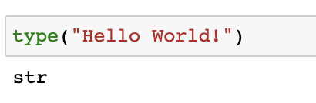
Basic data types
Integer（整型）: 12
Float （浮点数）: 3.14
Boolean （布尔值） : True, False
String（字符串）: “Hello World!”
Use type() to find out the type of a variable:

Slide 17
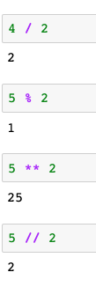
Integers (整型)
Integers are whole numbers (positive, negative or zero)
Arithmetic operators
(算数运算符)
+ - * /
// :floor division (取整除)
% ： remainder (取余)
** ：exponentiation (取幂)

Slide 18

Floats (浮点数)
Floats are numbers expressed in the decimal system
Operators for floats
+ - * / % **
Power of ten: 3.2e5 (means 3.2 * 10⁵)

Slide 19
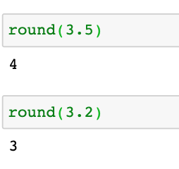
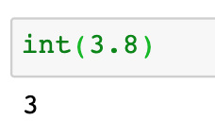
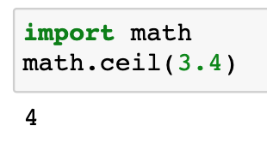
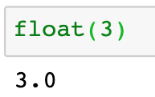
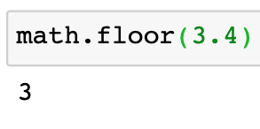
Float operations
We can add extra functionality by importing modules
round()
Convert between int and float
4. Convert between int and float
2. math.ceil()
3. math.floor()

Slide 20
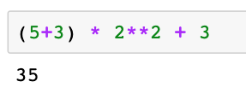
Float operations
Operation orders:
() > ** > *,/ > +,-
Notes:
(5+3) * 2 ** 2 + 3

Slide 21
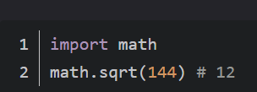
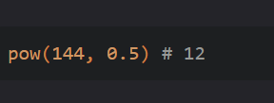

Float operations
Python开平方的三种方法：
1. 实用math模块
2. 内置函数 pow
3. 实用数学表达式

Slide 22
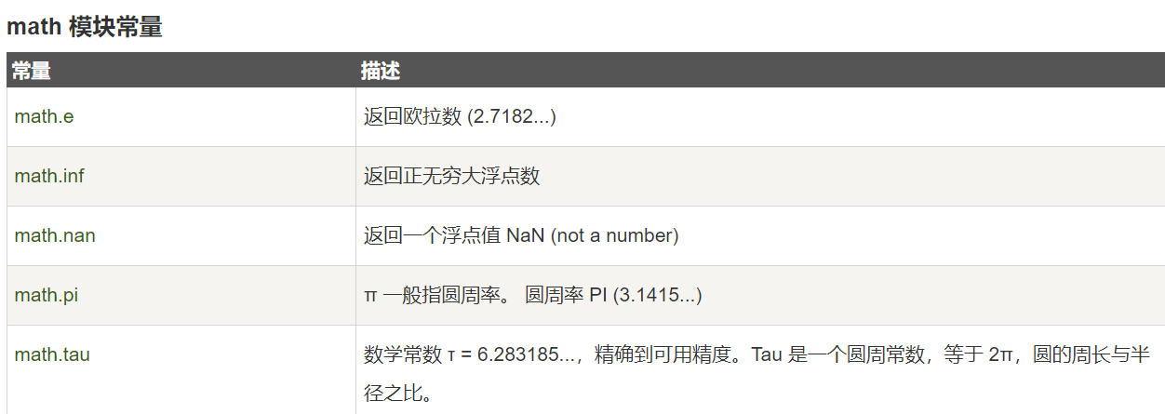
Float operations
Python math模块
Python math 模块提供了许多对浮点数的数学运算函数。
math 模块下的函数，返回值均为浮点数，除非另有明确说明。

Slide 23
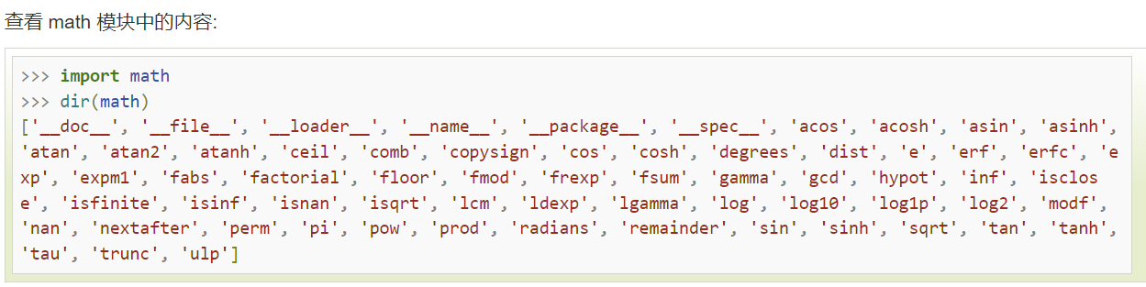
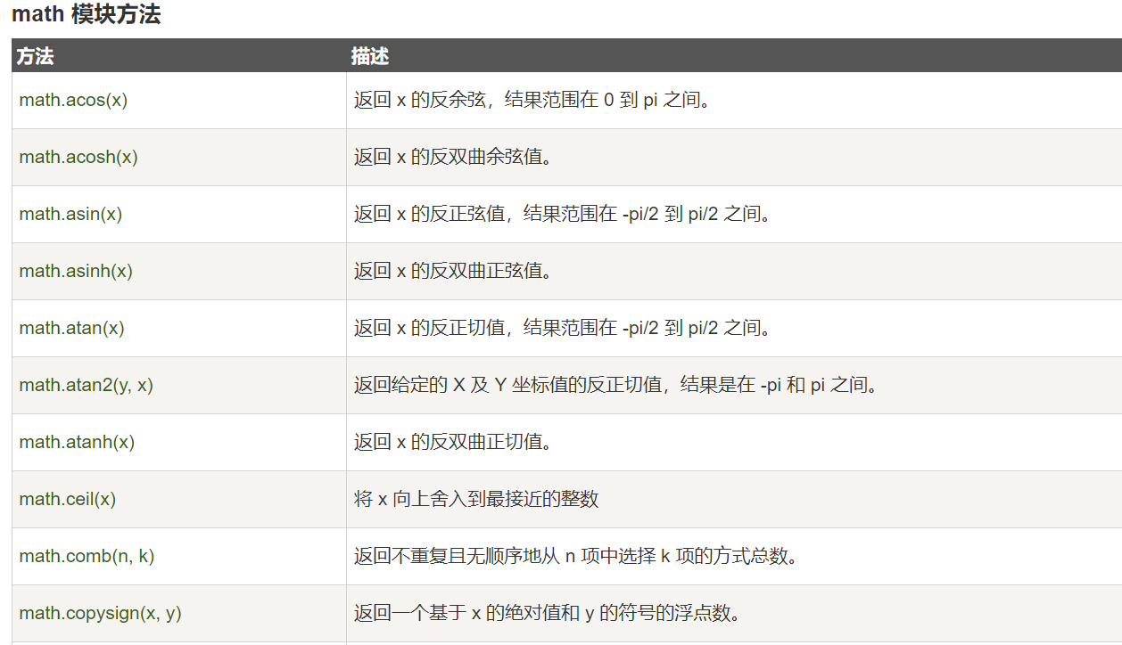
Float operations
Python math模块

Slide 24
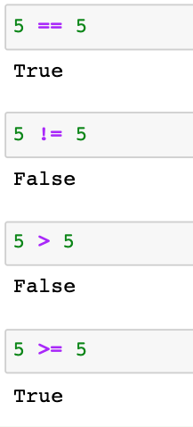
Booleans (布尔值)
True & False
Comparison operators:
== : equals
! = :does not equal
> :greater than
>= :greater than or equal

Slide 25
Booleans (布尔值)
True & False
Comparison operators:
== : equals
! = :does not equal
> :greater than
>= :greater than or equal
Similarly, we have < and <=.
The output of comparison operators is always a Boolean value, either True or False

Slide 26

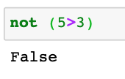

Logical operators
The logical operators are used for comparing logical values of their operands and to return the resulting logical value
and / &
True and False yields False
or / |
True or False yields True
not
not True yields False

Slide 27
Logical operators
The logical operators are used for comparing logical values of their operands and to return the resulting logical value
P | Q | P and Q | P or Q | Not P
True | True | True | True | False
True | False | False | True | False
False | True | False | True | True
False | False | False | False | True

Slide 28
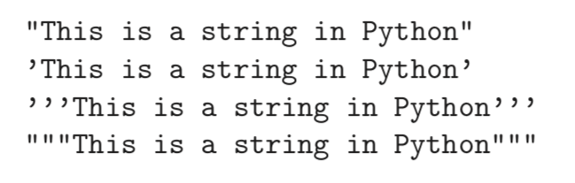
String (字符串)
An ordered sequence of characters (including numbers)
Delimited by a single quote (’), double quotes ("), triple single quotes (”’), or triple double quotes (""")

Slide 29
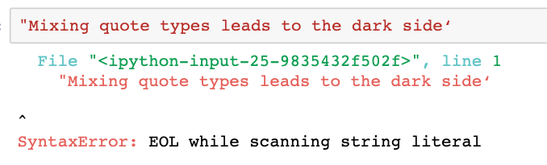
String
If we begin a string with a type of quote, we must finish it with the same type of quote.
Notes:
"Mixing quote types leads to the dark side‘

Slide 30
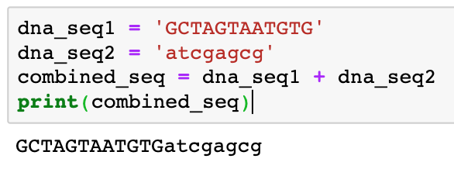
String basics
Strings can be concatenated using the “+” operator:

Slide 31
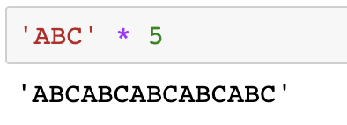
String basics
Strings can also be repeated using the “*” operator:

Slide 32
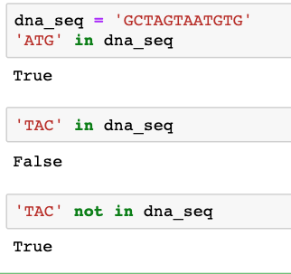
String basics
in and not in: check if a substring is / is not contained in a string
Notes:
In Python, strings use the ASCII value of characters for comparison

Slide 33
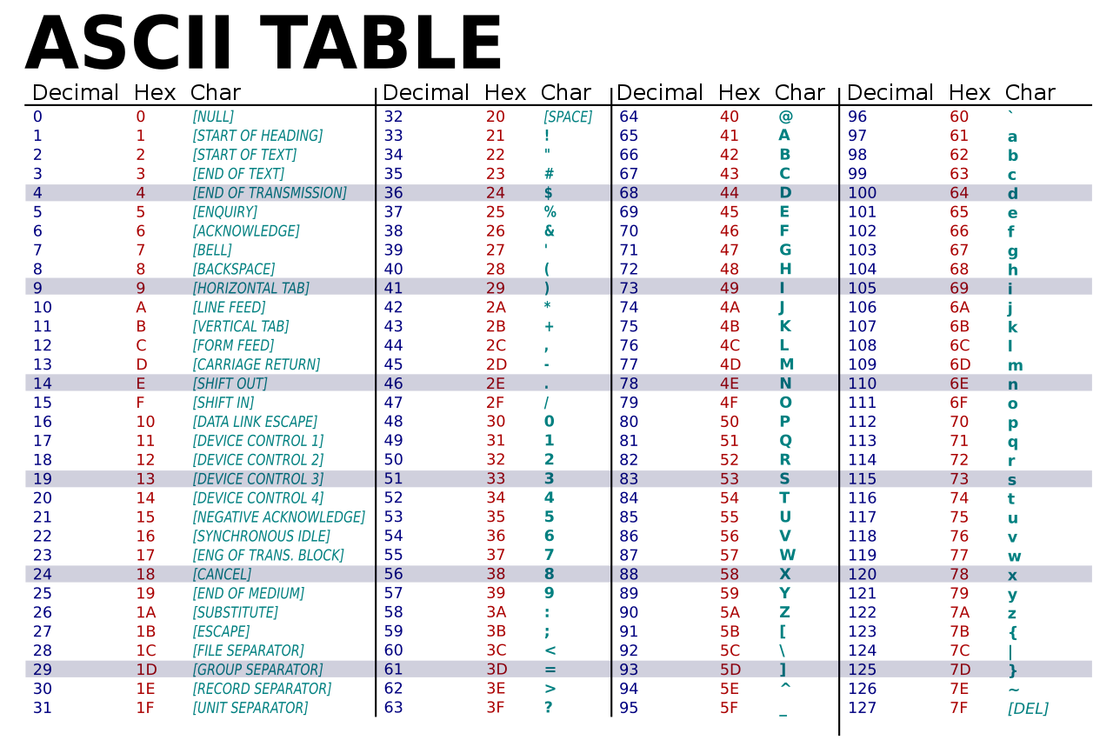
String basics
Compare strings: Python compares strings based on the ASCII value of the characters using >, <, <=, >=, ==, !=:
ASCII stands for American Standard Code for Information Interchange. Computers can only understand numbers, so an ASCII code is the numerical representation of a character
Notes:
In Python, strings use the ASCII value of characters for comparison

Slide 34
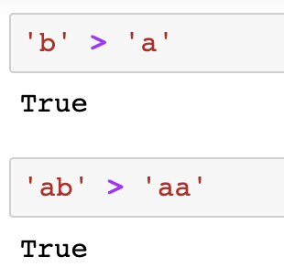
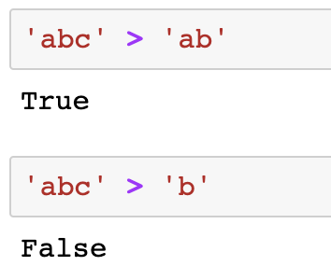
String basics
Compare strings: Python compares strings based on the ASCII value of the characters using >, <, <=, >=, ==, !=:
Notes:
In Python, strings use the ASCII value of characters for comparison

Slide 35
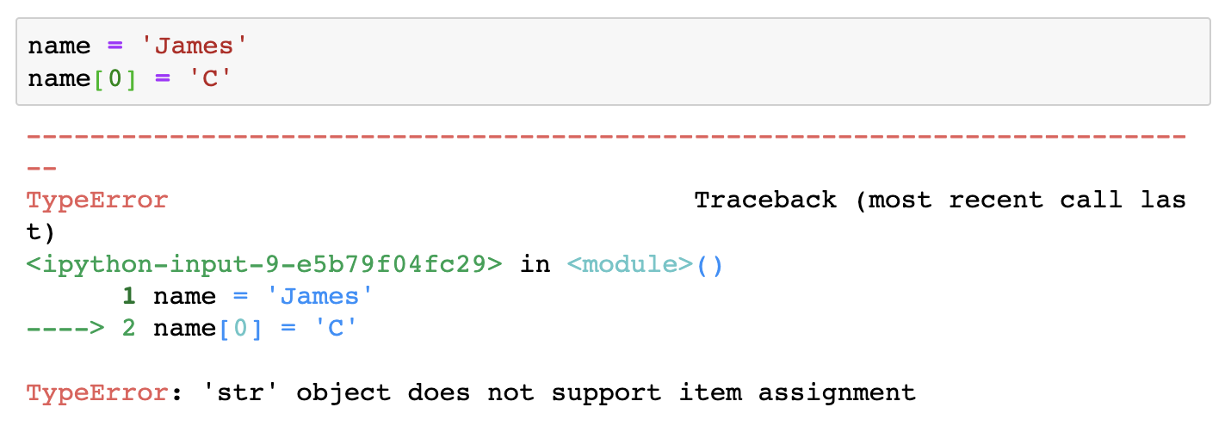
String basics
Strings are immutable (不可变的). The characters in a string cannot be changed once a string value is assigned to a string variable.

Slide 36
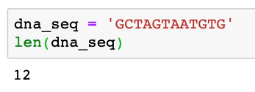
Built-in functions for strings
len():
Return the number of characters in a string
Notes:
dna_seq = 'GCTAGTAATGTG'
dna_seq[len(dna_seq)]

Slide 37
String indexing (索引)
To access a certain character in a string
Each of the string’s character corresponds to an index number starting from 0; square brackets (方括号) are used to perform indexing in a string；Use - to count from the last
Notes:
dna_seq = 'GCTAGTAATGTG'
dna_seq[len(dna_seq)]

Slide 38
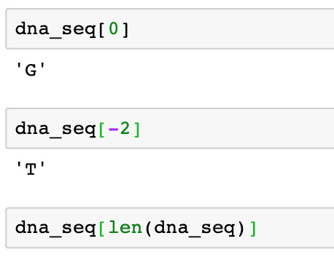
String indexing (索引)
To access a certain character in a string
Each of the string’s character corresponds to an index number starting from 0; square brackets (方括号) are used to perform indexing in a string；Use - to count from the last
Notes:
dna_seq = 'GCTAGTAATGTG'
dna_seq[len(dna_seq)]

Slide 39
String indexing (索引)
To access a certain character in a string
Each of the string’s character corresponds to an index number starting from 0; square brackets (方括号) are used to perform indexing in a string；Use - to count from the last (starting from -1)
?
Notes:
dna_seq = 'GCTAGTAATGTG'
dna_seq[len(dna_seq)]

Slide 40
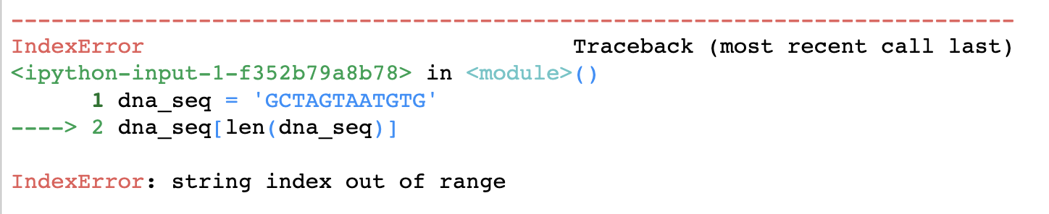
String indexing (索引)
To access a certain character in a string
Each of the string’s character corresponds to an index number starting from 0; square brackets (方括号) are used to perform indexing in a string；Use - to count from the last (starting from -1)
?
Notes:
dna_seq = 'GCTAGTAATGTG'
dna_seq[len(dna_seq)]

Slide 41
String slicing
To obtain a sub-string from the given string
string_x [start: stop: step]
positions are inclusive at the start, but exclusive at the stop
the index numbers are separated by a colon： (冒号)
string_x[start:stop] # characters start through stop-1
string_x[start:] # characters start through the rest of the string
string_x[:stop] # characters from the beginning through stop-1
string_x[:] # a copy of the whole string
string_x[start:stop:step] # start through stop-1, by step
Notes:
dna_seq = 'GCTAGTAATGTG'

Slide 42
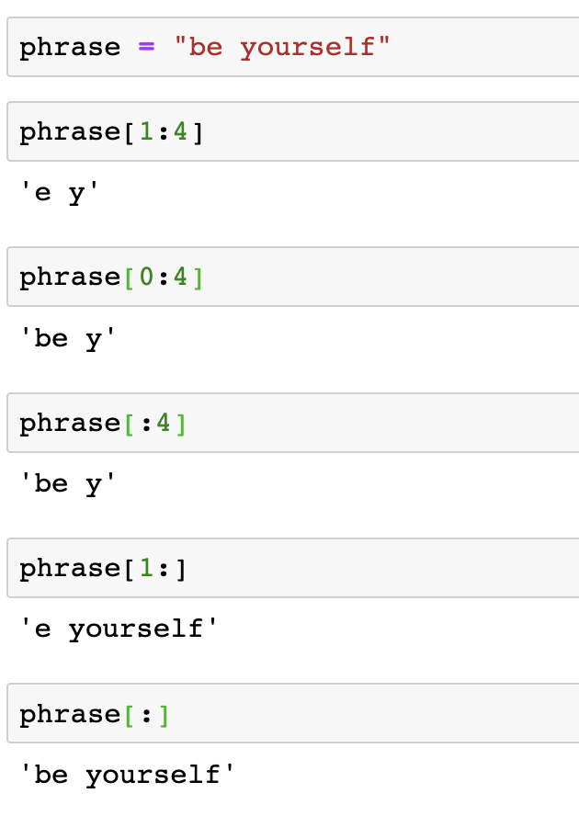
String slicing
To obtain a sub-string from the given string
string_x [start: stop: step]
positions are inclusive at the start, but exclusive at the stop
the index numbers are separated by a colon (冒号)
Notes:
dna_seq = 'GCTAGTAATGTG'

Slide 43
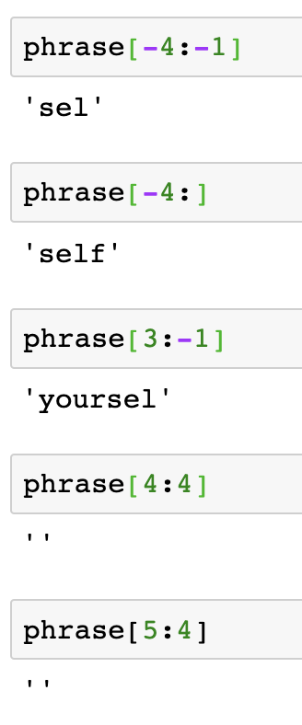
String slicing
To obtain a sub-string from the given string
string_x [start: stop: step]
positions are inclusive at the start, but exclusive at the stop
the index numbers are separated by a colon (冒号)
Notes:
dna_seq = 'GCTAGTAATGTG'

Slide 44
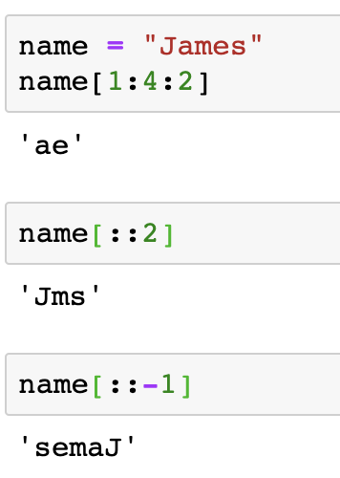
String slicing
To obtain a sub-string from the given string
string_x [start: stop: step]
step can be specified to specify steps in slicing; the default value of step is 1
Notes:
dna_seq = 'GCTAGTAATGTG'

Slide 45
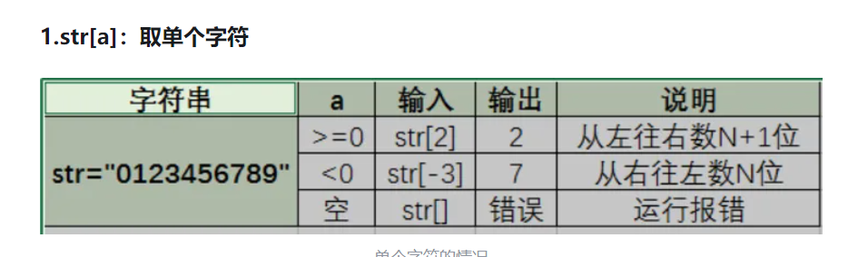
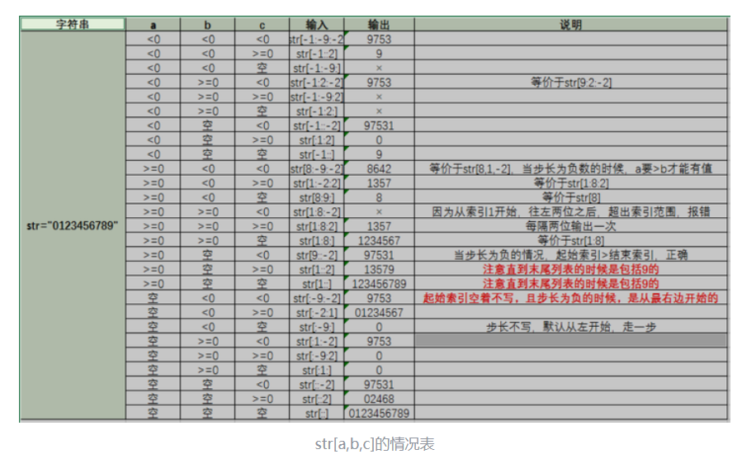
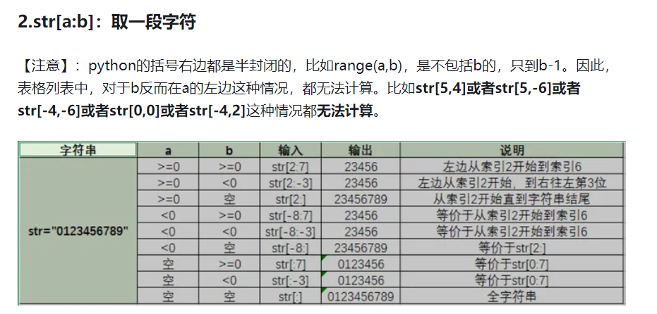
String slicing
str[a:b:s]：步长字符串

Slide 46
String methods
Python has a set of built-in methods that can be used on strings.
All string methods returns new values. They do not change the original string.
https://www.w3schools.com/python/python_ref_string.asp

Slide 47
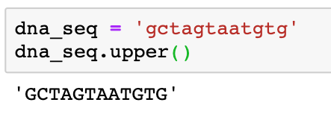
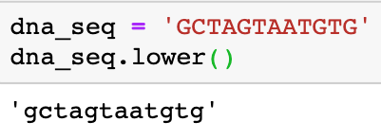
String methods
lower(), upper(): Convert strings to lower/upper cases
string.lower() string.upper()

Slide 48
String methods
replace(): Returns a string where a specified value is replaced with a specified value
string.replace(oldvalue, newvalue, count)
Parameter | Description
oldvalue | Required. The string to search for
newvalue | Required. The string to replace the old value with
count | Optional. A number specifying how many occurrences of the old value you want to replace. Default is all occurrences

Slide 49
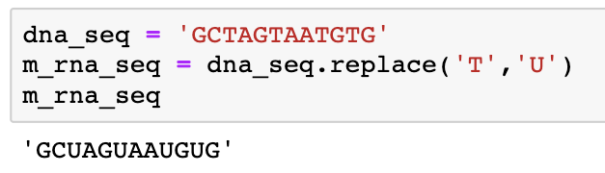
String methods
replace(): Returns a string where a specified value is replaced with a specified value
string.replace(oldvalue, newvalue, count)

Slide 50
String methods
count(): Returns the number of times a specified value appears in the string.
string.count(value, start, end)
Parameter | Description
value | Required. A String. The string to value to search for
start | Optional. An Integer. The position to start the search. Default is 0
end | Optional. An Integer. The position to end the search. Default is the end of the string

Slide 51
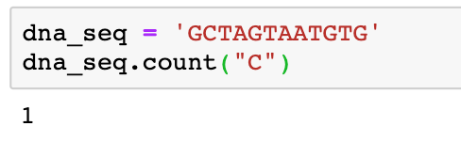
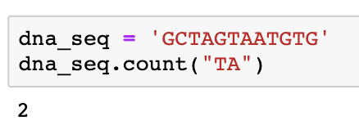
String methods
count(): Returns the number of times a specified value appears in the string.
string.count(value, start, end)

Slide 52
String methods
find(): Returns the position of the substring sub, between the start and end positions (if available). If the substring is not found in the string, this method returns the value -1
string.find(value, start, end)
Parameter | Description
value | Required. The value to search for
start | Optional. Where to start the search. Default is 0
end | Optional. Where to end the search. Default is to the end of the string

Slide 53
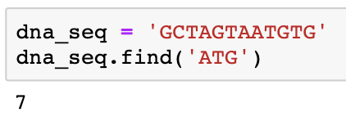
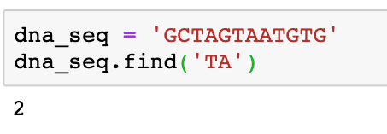
String methods
find(): Returns the position of the substring sub, between the start and end positions (if available). If the substring is not found in the string, this method returns the value -1
string.find(value, start, end)

Slide 54
String methods
split(): splits a string into a list. If a separator (sep) is not specified, the default separator will be a white space.
string.split(separator, maxsplit)
Parameter | Description
separator | Optional. Specifies the separator to use when splitting the string. By default any whitespace is a separator
maxsplit | Optional. Specifies how many splits to do. Default value is -1, which is "all occurrences"
Notes:
experiment_name = '08242021-trl-westernblot'
experiment_name.split('-’)
record in a new variable

Slide 55
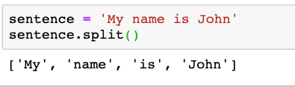
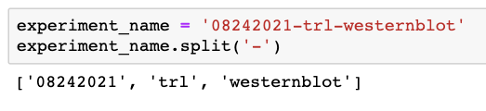
String methods
split(): splits a string into a list. If a separator (sep) is not specified, the default separator will be a white space.
string.split(separator, maxsplit)
Notes:
experiment_name = '08242021-trl-westernblot'
experiment_name.split('-’)
record in a new variable

Slide 56
String methods
startswith(), endswith(): returns True if the string starts or ends with the specified value, otherwise False.
string.startswith(value, start, end)
string.endswith(value, start, end)
Parameter | Description
value | Required. The value to check if the string starts with
start | Optional. An Integer specifying at which position to start the search
end | Optional. An Integer specifying at which position to end the search
Notes:
experiment_name = '08242021-trl-westernblot'
experiment_name.split('-’)
record in a new variable

Slide 57
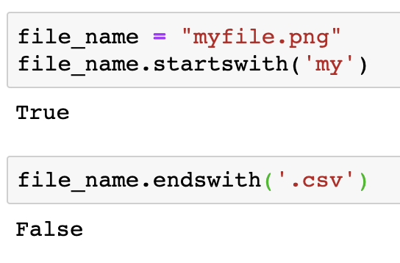
String methods
startswith(), endswith(): returns True if the string starts or ends with the specified value, otherwise False.
string.startswith(value, start, end)
string.endswith(value, start, end)
Notes:
experiment_name = '08242021-trl-westernblot'
experiment_name.split('-’)
record in a new variable

Slide 58
String methods
strip() : removes any leading and trailing characters (space is the default leading character to remove)
string.strip(characters)
Parameter | Description
characters | Optional. A set of characters to remove as leading/trailing characters
Notes:
experiment_name = '08242021-trl-westernblot'
experiment_name.split('-’)
record in a new variable

Slide 59
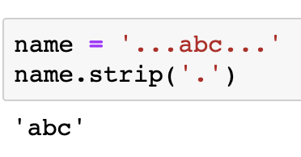
String methods
strip() : removes any leading and trailing characters (space is the default leading character to remove)
string.strip(characters)
Notes:
experiment_name = '08242021-trl-westernblot'
experiment_name.split('-’)
record in a new variable

Slide 60
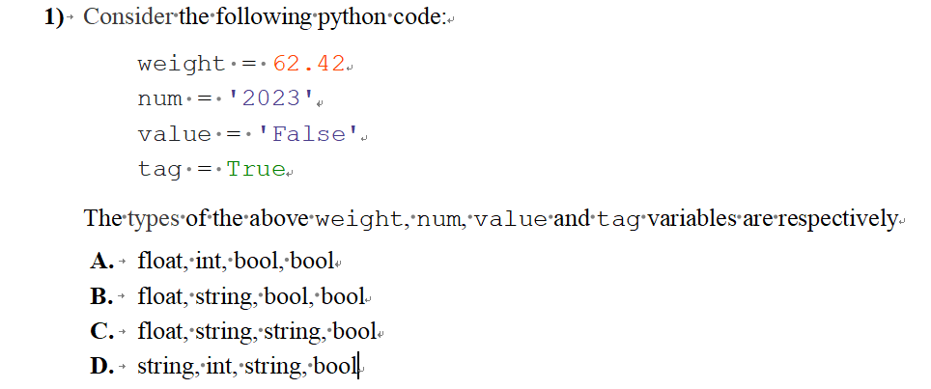
Practice

Slide 61
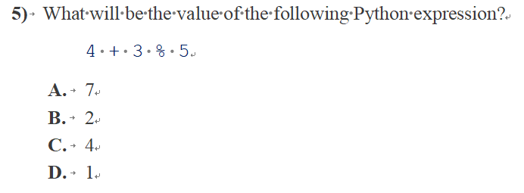
Practice

Slide 62
Practice
>>> a = ‘A’
>>> 2*A
a) AA
b) 2A
c) A2
d) None of the above
>>> a = ‘A’
>>> b = ‘B’
>>> a + b
a) A + B
b) AB
c) BA
d) None of the above

Slide 63
Practice
>>> a = ‘SUSTECH CS112’
>>> a[1 : len(a)]
a) SUSTECH
b) SUSTECH CS112
c) USTECH CS112
d) None of the above
>>> a = ‘SUSTECH CS112’
>>> a[-5 : len(a)]
a) CS112
b) S112
c) 112
d) None of the above

Slide 64
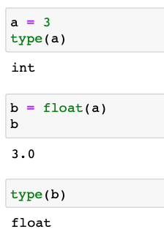
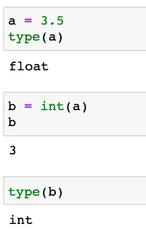



Conversion between data types
float to int
int/float to string
string to int/float
int to float
Notes:
experiment_name = '08242021-trl-westernblot'
experiment_name.split('-’)
record in a new variable

Slide 65


Print formatting
To print in a certain format
1. Using the Modulo Operator: %
‘d’ : integer.
‘f’ or ‘F’ : Float.
‘s’ : String.
Notes:
print('%d %s %d' % (2*2, 'is less than', 3*3))

Slide 66


Print formatting
To print in a certain format
2. Using the format() function
Notes:
print('The result of %s is %d' % ('2*2', 2*2))

Slide 67
Print formatting
To print in a certain format
3. Using f-Strings
To create f-strings, you only need to add an f or an F before the opening quotes of your string.
When using f-Strings to display variables, you only need to specify the names of the variables inside a set of curly braces {}. And at runtime, all variable names will be replaced with their respective values.
Notes:
print('The result of %s is %d' % ('2*2', 2*2))

Slide 68

Print formatting
To print in a certain format
3. Using f-Strings
To create f-strings, you only need to add an f or an F before the opening quotes of your string.
Notes:
print('The result of %s is %d' % ('2*2', 2*2))

Slide 69

Print Special Characters
\n – Newline.
\t- Horizontal tab.
\r- Carriage return.
\b- Backspace.
\f- Form feed.
\’- Single Quote.
\”- double quote.
\\-Backslash.

Slide 70


Escape sequences (转义字符串)
An escape sequence is a sequence of characters that, when used inside a character or string, does not represent itself but is converted into another character or series of characters.
\n – Newline.
\t- Horizontal tab.
\r- Carriage return.
\b- Backspace.
\f- Form feed.
\’- Single Quote.
\”- double quote.
\\-Backslash.

Slide 71
Escape sequences (转义字符串)
An escape sequence is a sequence of characters that, when used inside a character or string, does not represent itself but is converted into another character or series of characters.
\n – Newline.
\t- Horizontal tab.
\r- Carriage return.
\b- Backspace.
\f- Form feed.
\’- Single Quote.
\”- double quote.
\\-Backslash.

Slide 72


Good programming practice
Make your codes readable :
1. Use meaningful variable names
e.g. calculate the area of a rectangle

Slide 73
Good programming practice
Make your codes readable :
1. Use meaningful variable names
2. Formatting style：
Coding style: PEP 8 (https://peps.python.org/pep-0008/)
Python Enhancement Proposal（Python 增强建议书）

Slide 74


Good programming practice
Python Enhancement Proposal（Python 增强建议书）

Slide 75





Good programming practice
Python Enhancement Proposal（Python 增强建议书）

Slide 76
Good programming practice
Make your codes readable :
3. Add comments to your code
Use block comments to document a small section of code. They are important as they help others understand the purpose and functionality of a given code block.
Comments starts with # and are ignored by the interpreter during the execution of the program.

Slide 77

Good programming practice
Make your codes readable :
3. Add comments to your code

Slide 78
课后练习
https://pynative.com/python-basic-exercise-for-beginners/

